Slide 1
PANIC DISORDER DIAGONOSIS PERDICTION
BY:
DURKA RAVIKUMAR

Slide 2
Agenda
Problem Statement
Project Flow
Data collection
Preprocessing
First Data-Frame
Class Imbalance
Outliers
Second Data-Frame
Feature Selection
Third Data-Frame

Slide 3
PROBLEM STATEMENT
The project's goal is to use predictive analytics to find patterns that point to the onset and severity of panic disorders.
The model seeks to improve early detection and individualized treatment plans by combining various data sources.“
"Developing a machine learning model for accurate diagnosis of panic disorder using symptom data and clinical assessments."

Slide 4
FLOW OF THE PROJECT
Data Collection
Data Preprocessing
Data Frame 1
Class Imbalance
EDA
Feature selection
Data Frame 2
Data Frame 3

Slide 5
DATA COLLECTION
In Dataset there are 50000rows and 17 columns.
It has 14columns consist of numerical values and 3 are categorical.
Target columns is categorical so, I perform Classification Method.

Slide 6
PREPROCESSING
Missing Value Treatment
Data Type Conversion
Duplicate Checking

Slide 7
DATA FRAME 1
S.no | Model Name | Accuracy | FPR | Tpr | f1score
0 | log | 96.68 | 0.633178 | 0.993627 | 0.988669
1 | dt | 99.89 | 0.009346 | 0.999269 | 0.993783
2 | rf | 99.48 | 0.121495 | 1.000000 | 0.978132
3 | nb | 95.72 | 1.000000 | 1.000000 | 0.978132
4 | svc | 95.72 | 1.000000 | 1.000000 | 0.978132
5 | knn | 95.74 | 0.992991 | 0.999896 | 0.978230
6 | adaboost | 99.89 | 0.009346 | 0.999269 | 0.999425
7 | xgboost | 100.00 | 0.000000 | 1.000000 | 1.000000

Slide 8
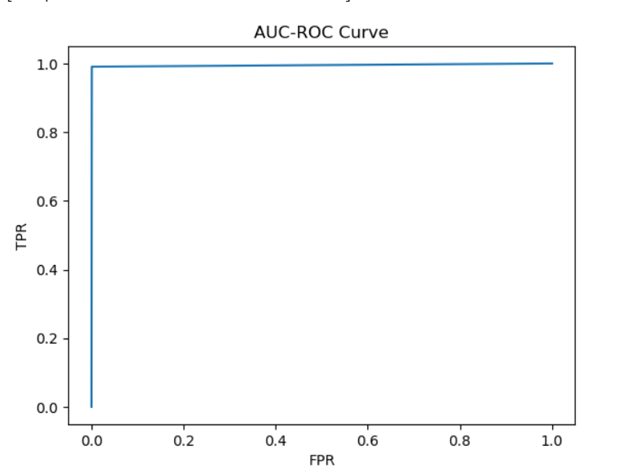
For this model Ada boost is best fitted model it having (99.89%) accuracy and (0.99) f1 score and (0.99) Tpr and Fpr is low(0.009)
Conclusion For Data Frame 1
Result of AUC-ROC curve

Slide 9
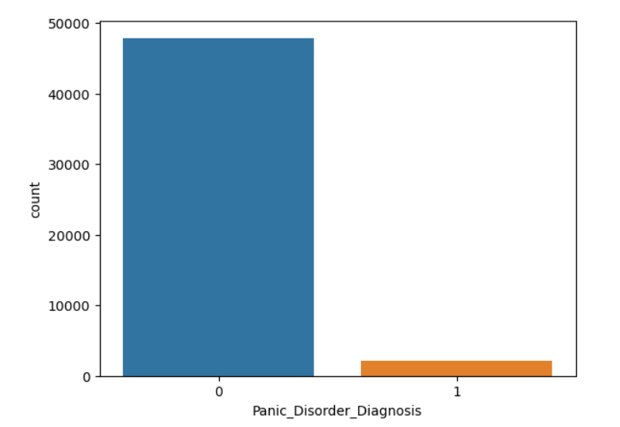
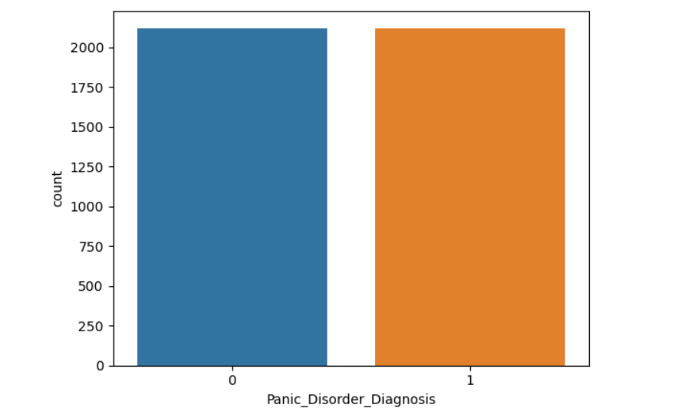
CLASS IMBALANCE
I perform under sampling technique these are before and after the class imbalance of Target Variable.
Before
After

Slide 10
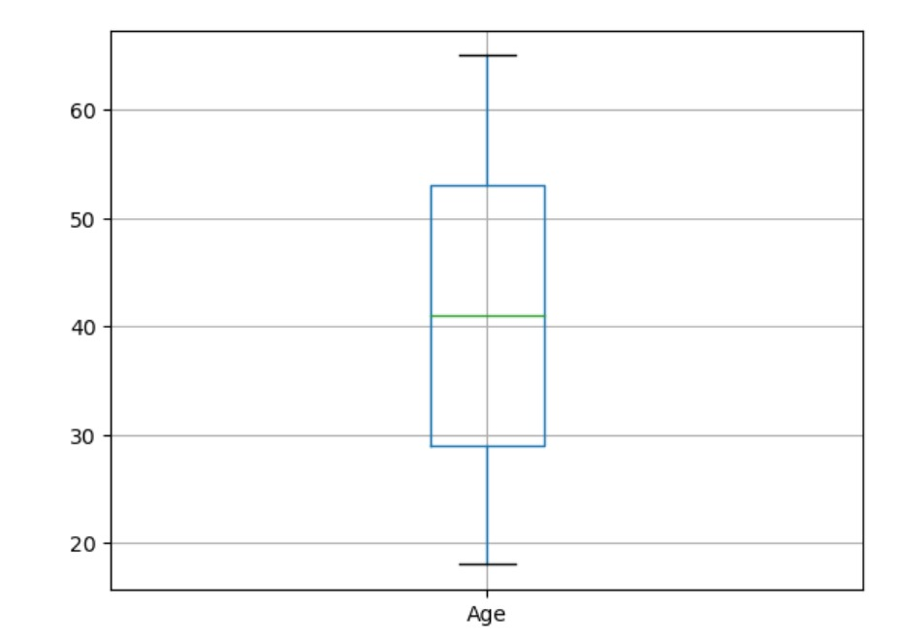
OUTLIERS
Box Plot For Outlier in data
Age

Slide 11
DATA FRAME 2
S.no | Model_Name | accuracy | Fpr | Tpr | f1score
0 | log | 90.812721 | 0.056373 | 0.875283 | 0.908235
1 | dt | 99.175501 | 0.002451 | 0.986395 | 0.992018
2 | rf | 98.351001 | 0.000000 | 0.968254 | 0.983871
3 | nb | 81.154299 | 0.154412 | 0.780045 | 0.811321
4 | svc | 86.219081 | 0.024510 | 0.757370 | 0.850955
5 | knn | 81.861013 | 0.017157 | 0.666667 | 0.792453
6 | adaboost | 99.175501 | 0.002451 | 0.986395 | 0.992018
7 | xgboost | 99.057715 | 0.000000 | 0.981859 | 0.990847

Slide 12
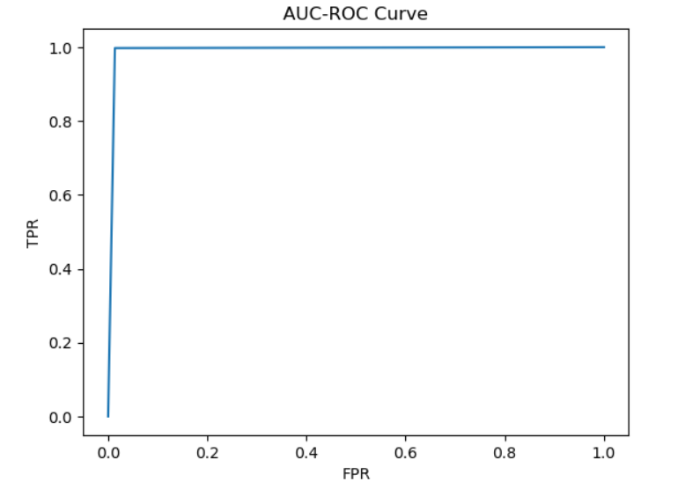
For this model Decision Tree is best fitted model it having (99.17%) accuracy and (0.99) f1 score and (0.98) Tpr and Fpr is low(0.002)
Conclusion For Data Frame 2
Result of AUC-ROC curve

Slide 13
Feature Selection
Perform Recursive Feature Elimination
Dataset having 15 column in that only 7 column selected as a importance feature which are significant.

Slide 14
DATA FRAME 3
S.no | Model_Name | accuracy | Fpr | Tpr | f1score
0 | log | 88.457008 | 0.056373 | 0.829932 | 0.881928
1 | dt | 98.115430 | 0.000000 | 0.963719 | 0.981524
2 | rf | 97.762073 | 0.000000 | 0.956916 | 0.977984
3 | nb | 71.378092 | 0.250000 | 0.680272 | 0.711744
4 | svc | 95.406360 | 0.000000 | 0.911565 | 0.953737
5 | knn | 89.163722 | 0.002451 | 0.793651 | 0.883838
6 | adaboost | 98.115430 | 0.000000 | 0.963719 | 0.981524
7 | xgboost | 98.115430 | 0.000000 | 0.963719 | 0.981524

Slide 15
Conclusion For Data Frame 3
Feature selection is not suitable for this data.
In this method FPR score is 0, For some algorithm
compare to class imbalance method in this feature selection accuracy was decrease.

Slide 16
Demerits
Data Limitations: Limited availability or quality of data related to panic disorder symptoms, leading to biased or inaccurate predictions.
Dynamic Nature of Symptoms: Panic disorder symptoms can vary widely among individuals and may change over time, making it challenging to develop a one-size-fits-all predictive model.
Ethical Concerns: Predicting mental health disorders like panic disorder using algorithms raises ethical concerns regarding patient privacy, consent, and potential stigmatization.

Slide 17
Thank you…

